Slide 1
The Case for Unencumbering Interest Rates at the Zero Bound
Author: Marvin Goodfriend
Presenter: Shen Wang
Professor: Philip Dybvig
9/19/2019

Slide 2
Agenda
Background
Economic Model
Reasons
Solutions
Personal View
1

Slide 3
1
A
Background: the Author and the Paper
Marvin Goodfriend
Paper Introduction
Education
  Brown University - PhD - 1980
  Union College - BS - 1972
Career
  Professor of Economics at Carnegie Mellon's Tepper School of Business
  Board of Governors of the Federal Reserve System in Washington, D.C. from 1993 to 2005
Policy Positions
  Conservative (freshwater)
  Critic of an actively regulating role of the Fed
  Repeatedly argues against quantitative easing
  Supports monetary policy based rule
  Willing to consider unusual monetary instruments in times of crisis, i.e. negative rates
Main idea
  Make the case for unencumbering interest rate policy so that negative nominal interest rates can be made freely available and fully effective as a realistic policy option in a future crisis.
Situation
  “Designing Resilient Monetary Policy Frameworks for the Future” in Jackson Hole Economic Policy Symposium
Solutions
  Abolish paper currency
  Introduce a market-determined flexible deposit price of paper currency
  Provide electronic currency (to pay or charge interest) at par with deposits
Source: Wikipedia
2

Slide 4
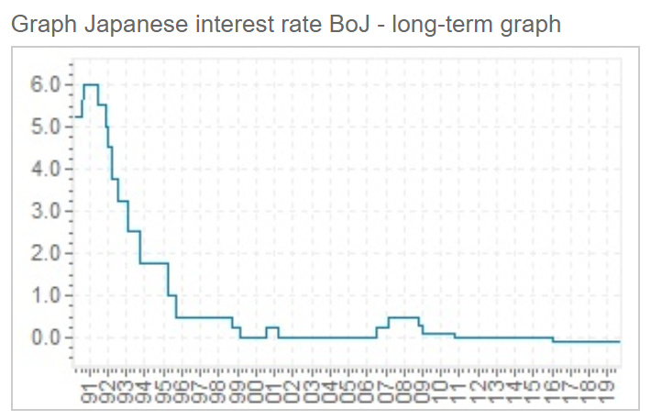
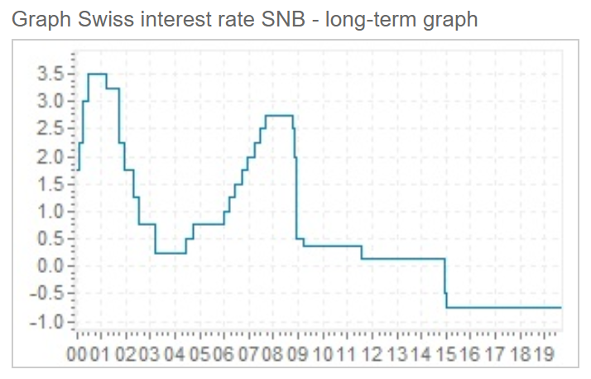
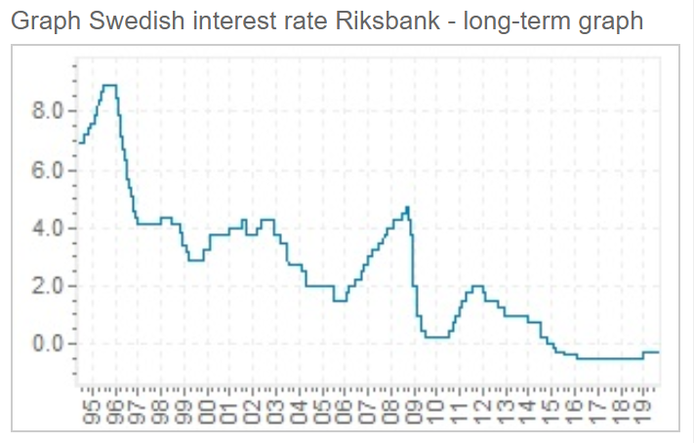
1
B
Background: Negative Interest Rate
Negative interest rate has been introduced to Switzerland, Sweden and Japan since December 2014, February 2015 and January 2016, respectively.
Source: global-rates.com
3

Slide 5
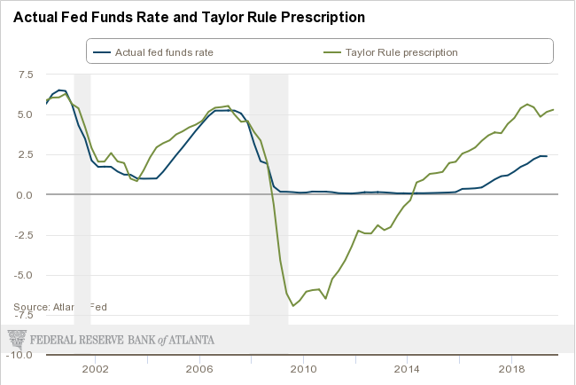
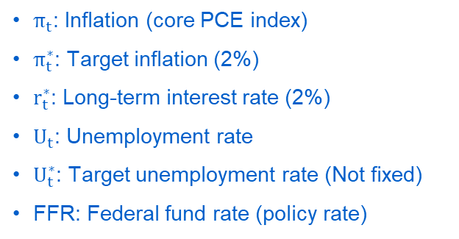

1
C
Background: Zero Lower Bound
Real Interest rate was not negative due to the zero bound
Taylor’s Rule (Evans Rule)
$${FFR}_{t}=π_{t+1}+r_{t}^{∗}+0.5\left(π_{t+1}−π_{t+1}^{∗}\right)+2.0(U_{t}^{∗}−U_{t})$$
$π_{t}$: Inflation (core PCE index)
$π_{t}^{∗}$: Target inflation (2%)
$r_{t}^{∗}$: Long-term interest rate (2%)
$U_{t}$: Unemployment rate
$U_{t}^{∗}$: Target unemployment rate (Not fixed)
FFR: Federal fund rate (policy rate)
Source: Atlanta FED
4

Slide 6
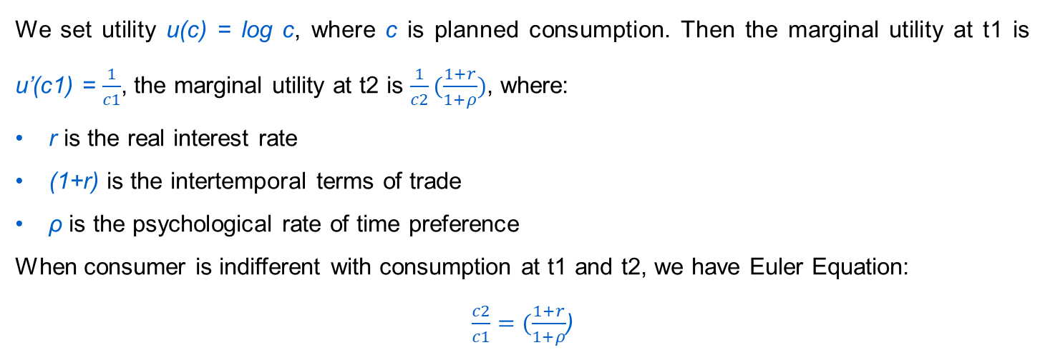
Economic Model
2
A
Step 1: Euler Equation
We set utility u(c) = log c, where c is planned consumption. Then the marginal utility at t1 is u’(c1) = $\frac{1}{c1}$, the marginal utility at t2 is $\frac{1}{c2}(\frac{1+r}{1+ρ})$, where:
r is the real interest rate
(1+r) is the intertemporal terms of trade
ρ is the psychological rate of time preference
When consumer is indifferent with consumption at t1 and t2, we have Euler Equation:
$\frac{c2}{c1}=(\frac{1+r}{1+ρ}$)
The more favorable (unfavorable) is the intertemporal terms of trade, the more (less) a household would like to lend in order to move consumption from the present to the future.
5

Slide 7
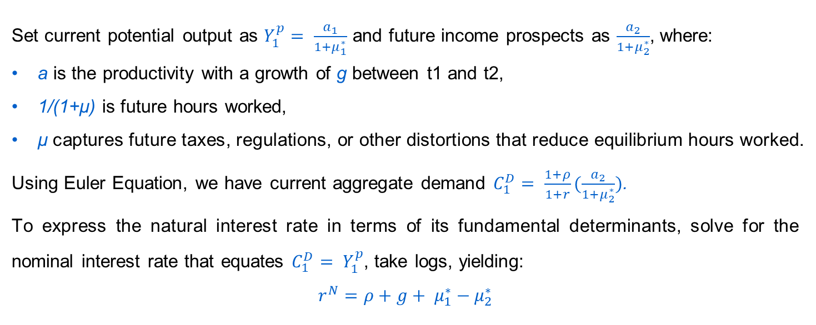
Economic Model
2
A
Step 2
Set current potential output as $Y_{1}^{p}= \frac{a_{1}}{1+μ_{1}^{∗}}$ and future income prospects as $\frac{a_{2}}{1+μ_{2}^{∗}}$, where:
a is the productivity with a growth of g between t1 and t2,
1/(1+μ) is future hours worked,
μ captures future taxes, regulations, or other distortions that reduce equilibrium hours worked.
Using Euler Equation, we have current aggregate demand $C_{1}^{D}= \frac{1+ρ}{1+r}(\frac{a_{2}}{1+μ_{2}^{∗}})$.
To express the natural interest rate in terms of its fundamental determinants, solve for the nominal interest rate that equates $C_{1}^{D}= Y_{1}^{p}$, take logs, yielding:
$$r^{N}=ρ+g+ μ_{1}^{∗}−μ_{2}^{∗}$$
  μ (i.e.taxes) ↑
  Future hours worked ↓
  r (Nominal Interest rate) ↓
  1+r (Intertemporal terms of trade) ↓
  g (growth) ↓
  ρ (preference to consume currently) ↓
6

Slide 8

3
Reasons: Global Factors Depressing Intertemporal terms of Trade
A
Main factor: Debt overhang
Other global development factors
  The average level of gross public debt to GDP in advanced countries as a whole exceeds the 90 percent. Take US as an example:
  Rising income inequality
  Population contraction
  Unsecured GDP of developing countries
  Waning support for trade liberalization
  Slowing global productivity growth
  Empirical result: debt overhang in advanced economies appears to slow the expected growth of potential output significantly
  Growing awareness of looming downside risks due to the incapacitation of monetary and fiscal stabilization policies
Decrease business dynamics
Encourage precautionary savings
Depressing intertemporal terms of trade
Lower hours worked
$$r=ρ+g+ μ_{1}^{∗}−μ_{2}^{∗}$$
Favorable tax and transferable policies
Lower discount rate
Higher future taxes
Source: St.Louis FED
7

Slide 9
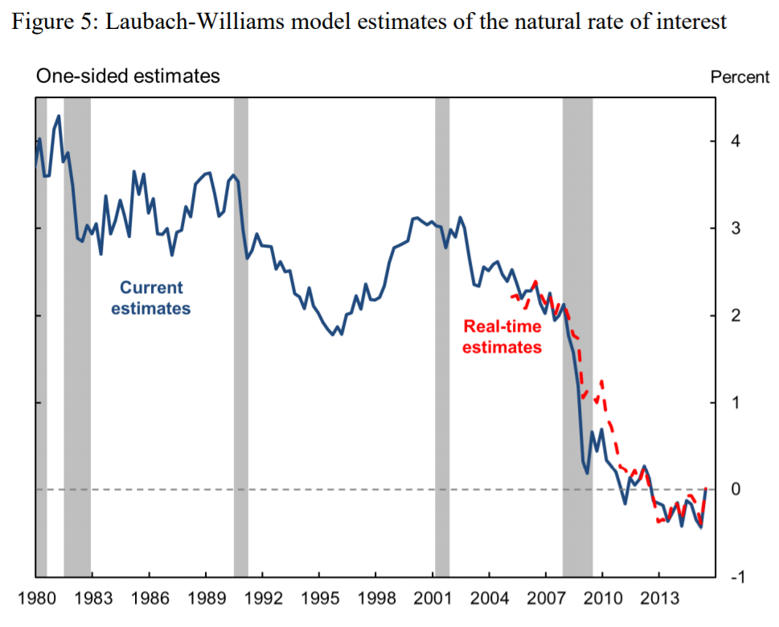
3
Reasons: Precipitous Decline in Long-term Market Interest Rates
B
TIPS (Treasury inflation-protected securities)
  10-year TIPS rate dropped below zero in 2013, and stayed around zero since then.
  Risk transfer compensation
  Compensation for bearing bond price fluctuations that may occur before the bond reaches maturity
  Intertemporal terms of trade
  Compensation of move wealth and therefore consumption to the future
Long-term natural interest rate
  Comparing two interest rates, the author gets the risk transfer compensation, which declined from 2% in 1990s to 0.5%-0% after 2008.
  A downturn of risk transfer compensation reflects low “interest rate hikes risk”.
  The long-term market interest rates is and will continue declining.
8
Source: Laubach, T. and J. C. Williams, 2015. Measuring the Natural Rate of Interest Redux, Federal Reserve Bank of San Francisco Working Paper Series 2015-16, (October); St. Louis FED

Slide 10
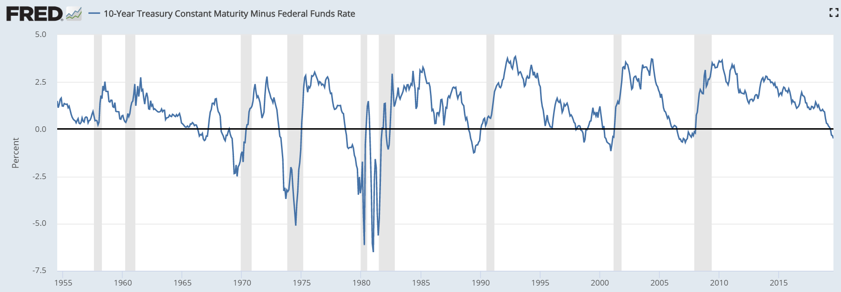
3
Reasons: Precipitous Decline in Long-term Market Interest Rates
B
  The low long term nominal interest rates leave little leeway for the usual cyclical decline of short rates below long rates in the recovery from recession.
  The long-term market interest rates is and will continue declining.
FED pushed the federal funds rate more than 2.5% below the 10-year nominal Treasury bond rate in 8 of 9 recessions after 1960.
Source: St.Louis FED
9
Notes:
1.63%

Slide 11
3
C
Reasons: An Evolution of Monetary Policy
Gold Standard
Fixed Foreign Exchange Rate
Money/goods = (money/gold)(gold/goods)
  Money/gold is fixed
  Satisfy a minimum required gold reserve ratio against aggregate money supply
A rise (fall) in the gold/goods would cause inflation (deflation)
Countries with gold inflow must buy gold and raise gold reserve ratio to prevent inflationary money supply
Raised the world demand for gold, depressed gold/goods, and created deflation pressure
The gold standard was finally abandoned completely in the early 1970s
  Fluctuations in the gold/goods could be reflected in the money/gold without destabilizing the general price level
A goods/B good = [(B money/B good)/(A money/A good)](A money/B money)
  A money/B money is fixed
The impossible trinity encumbers monetary policy by tying the money/good directly to the international terms of trade
  An improvement in Country A’s terms of trade, i.e., a fall in the A goods/B good, forces inflation in Country A or deflation in Country B
Fixed exchange rates have been abandoned since the 1970s
  Floating exchange rates could reflect fluctuations in the international terms of trade
  Central banks could pursue interest rate policies independently
Similarly, the zero bound encumbers monetary policy to control independently the price and employment level.
By removing zero bound, movements in the intertemporal terms of trade can be reflected fully in policy interest rate.
10

Slide 12
3
D
Reasons: To Prevent Fiscal Policy and Balance Sheet Stimulus
Expansive central bank balance sheet stimulus is increasingly ineffective
Interest rate policy will prevent central banks to exert stimulus via fiscal policy
Far more flexible, less intrusive of markets, interest rate policy is far superior as a general-purpose stabilization policy, free of credit and interest rate risk for central bank.
11

Slide 13
4
3 Methods to Unencumber Interest Rate Policy at the Zero Bound
A
Central bank creates excessive reserves
Central bank charges negative interest rate (storage fee) for banks
Banks are forced to lend reserve to each other, dragging down interbank interest rate below zero and retail deposits rate around zero
Now: central bank to banks
Abolish Paper Currency
To prevent a widespread destructive disintermediation of financial markets
Introduce a Flexible Market-Determined Deposit Price of Paper Currency
To let fluctuations in the deposit demand for paper currency be reflected in the deposit price of paper currency so as not to destabilize the general price level.
Provide Electronic Currency (to Pay or Charge Interest) at Par with Deposits
The central bank could easily pay or charge interest on electronic currency
Future: spread to all the people
12

Slide 14


5
Personal View
A
Reasons | Global Factors |  | 1. Disagree that debt overhang is the main factor 2. Global development and inequality might be the underlying issues
 | Low long-term rates |  | 1. Solid 2. Reality: another rate cuts yesterday
 | Compare with past monetary policy |  | 1. Not a rigorous analogy 2. Flexible paper money price is understandable
 | Prevention of fiscal tools |  | 1. Fiscal tools are not that bad 2. FED actually prefers fiscal tools compared to negative interest rates 3. How about other monetary tools? i.e. ELB-adjusted rule or Inertial rule to decide federal fund rate
Solutions | Abolish paper money |  | 1. A little bit too far 2. Might be available in the future
 | Flexible paper money price |  | 1. What I like most! 2. Creative and solid
 | Electronic currency |  | Not far from us
13

Slide 15
5
Personal View
B
Global development is a more crucial issue
Be inclusive and creative in terms of economic tools
14

Slide 16
THANKS!

